Slide 1
Online Presence Builder
DIY website. Create a website that is right for your business and optimized to look great on any device.

Slide 2
Agenda
1
2
3
4
Importance of Online Presence Builder
Online Presence Builder
Features & Benefits Overview
Addressing Common Concerns

Slide 3

Websites level the playing field
A website instills trust and credibility. It serves as a platform to showcase products or services and a professional website can level the playing field with larger competitors.
In today's digital landscape, the absence of a website means missing out on potential revenue streams - over 90% of consumers search online, without a website, business is invisible to them.
As per local GE Capital Retail Bank, 2022
81%
Of internet users research products online before they make a purchase

Slide 4
Cost of not having a website
Lack of trust
Customers tend to trust businesses they can find online so they can see what they offer before visiting the business.
Lack of customer engagement
Businesses miss out on opportunities to build relationships with customers and foster loyalty.
Lack of insights
Businesses miss out on the opportunity to gather valuable data and insights about customers, their preferences, and their behaviors.
Missed sales opportunities
If customers can’t find you online, they will go to the competition. First impressions matter. If you meet a customer in person, they may not want to do business with a company that doesn’t have any online presence
Lack of Communication
Unable to post store hours, if businesses offer curbside pick up, photos of the products/ food offered. Unable to provide important information that prospects are looking for on a website.
Lack of scalability
Businesses struggle to expand into new markets, launch new products or services, or cater to a growing customer base without an online platform to support these efforts.

Slide 5
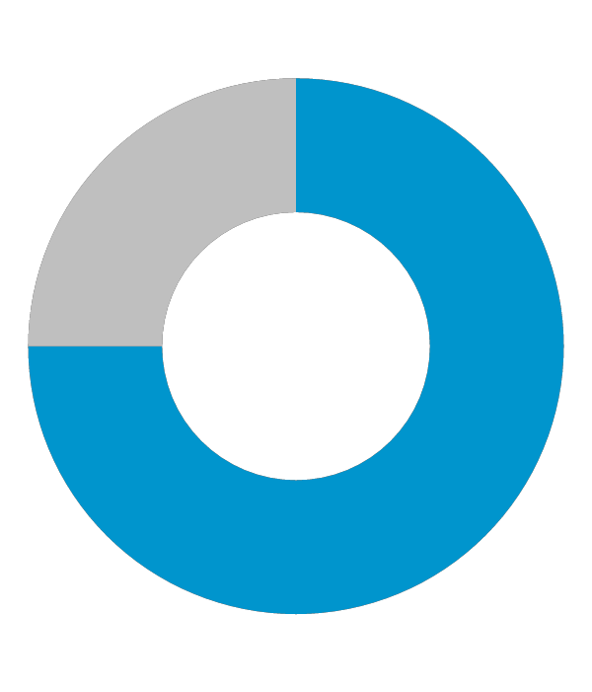
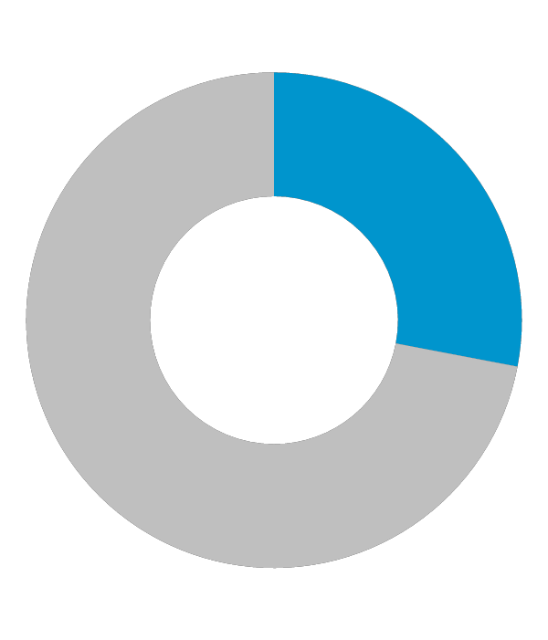
Impact of websites on businesses
90%
71%
88%
of people are online, without a website your business is invisible
Themeisle
Of customers wont return to a website if they have a negative experience.
Forbes
Of small businesses have a website
Forbes

Slide 6
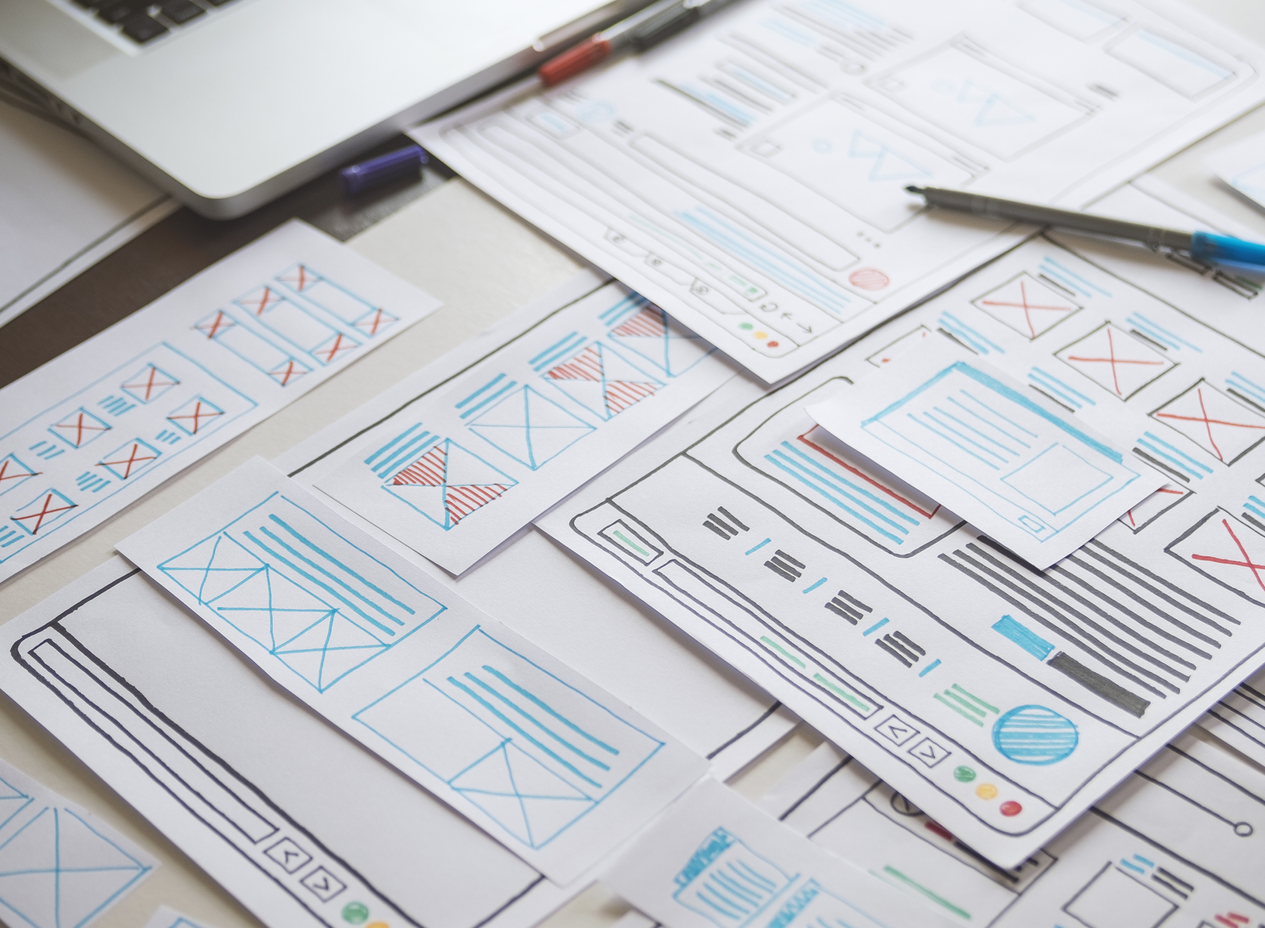
Online Presence Builder
Instant online presence
Easy-to-use website editor
Modern themes designed optimized for all devices
Gallery of professional images
Engaging elements

Slide 7

Discover Online Presence Builder Editor
Instant Online Presence Website
Sample industry content pre-populated
Contact us information pre-populated
Email contact form auto-generated
Using the business information submitted, online presence builder will generate relevant images, content, a map and contact form on a template of your choosing

Slide 8
Features
Drag and Drop Editor
User friendly, add as many pages as you need. Preview site in desktop, mobile and tablet views.
Modern Design Themes
Mobile optimized for tablets and smartphones, hero images, change the theme at any time, customize fonts and color scheme. We have 215 designs available in up to 7 different colors.
Professional Images
Access a free gallery of 830 professional, royalty free, modern images to use on your online presence. All images are optimized for website use.
Engaging Elements
Pre-formatted blocks, add sleek galleries in different layouts, add a Facebook like and follow button, add a Google map and open hours, layout content in rows, tabs, columns. Add lead form, call to action

Slide 9
How it works

Slide 10
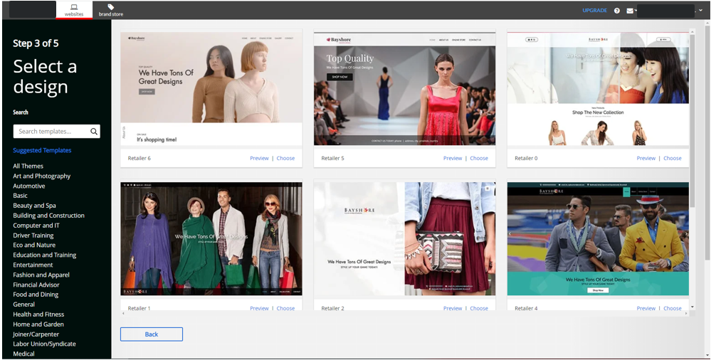
Login to your portal and access Online presence builder
Go through the “websites” tab in your portal. Select the domain to use for the site. Click get started
Fill out your business information and select and business category. The details will be used to generate relevant images content, map and content form
Select a design theme and click preview.
At this time, you can add a logo. Click create and the site will propagate.
You can then make any edits through online presence builder and publish.

Slide 11
Benefits
Our Drag and Drop editor allows users to easily create a website and even create a One-Page Website with a few clicks.
Made for everyone
Cost effective
Get all the key features needed to build, market and manage a website at an affordable price.
Access an intuitive online dashboard to manage your online presence, domain, and other services.
View website analytics, including traffic, clicks and most popular pages.
Easy Management
24/7 Access
Manage your website from anywhere that has internet connection

Slide 12
Q & A / Next steps

Slide 13
Frequently Asked Questions

Slide 14
1. How do I use Online presence builder?
Launch Online Presence Builder. You can select a new design from a selection of brand new, stylish designs created by professionals (and remember you can change your design at any time). Customizing your site by dragging and dropping your elements onto the page. Select elements from the left-hand menu (for example a heading, text or image), drag and drop it on to your web page, and double-click to edit the element.
We’ve included a user guide to help walk you through the process of upgrading your website using the new Online Presence Builder.
3. Can I change my design once I select it?
Yes, you can change your design at any time. Select “Design” in the tool to view the available designs. You also have the option to preview how existing content will look with the new design before making the change.
2. Do I need to build a separate mobile site with the Online Presence Builder?
No – Online Presence Builder uses a responsive design to automatically adapt your site to look great on every device: desktop, mobile or tablet. There’s no need for you to spend the time in developing a separate, mobile-friendly site. Your website will automatically adapt to the device your visitors are using, with the important details front and center. When designing and editing your website, you can preview how it looks on a desktop, tablet or mobile view.
4. Can I transfer my existing website to the new Online Presence Builder?
Not at this time. We built the new Online Presence Builder with fresh new designs that are SEO-friendly. Once you choose a design template, you can easily copy and paste text and upload your existing images into the Online Presence Builder. You might take this opportunity to refresh your content and make sure your details are up to date. When you’re finished, you’ll have fantastic, new site that looks great on every device.

Slide 15
Probing Questions

Slide 16
What would happen if I Googled what your business offers, in your city? Would your business show up?
Do you know that 9 out of 10 purchases start online? You need to get found online. You could be losing customers every day to your competitors.
Stop losing business to the competition who are getting in front of your potential customers online. Online Presence Builder allows anyone to build impressive websites that perform on every screen and help you get found online. Plus, a domain and branded email, features that drive your visitors to action, all accessible in one simple interface. Save time and make an impact.
What do you think?
Do you have a website?
Yes?
How could your website be improved: design, mobile-friendly, selling online, attract new customers?
No?
Great, don’t lose any more time waiting! It’s important to have a professional online presence so customers can trust your business’ credibility.
Online Presence Builder is a really great, cost-effective way to get started online that won’t take up your time. There’s a two-step on-boarder that produces a fully responsive (meaning optimized for tablets and smartphones) website with your contact info, a Google map and lead form that sends inquires to your email. Then you can add more pages and customize it whenever you decide.
How often are you updating your website?
Websites that are updated between 30-60 days are going to show up higher in search engine rankings because the material is viewed as fresh and up to date. With Online Presence Builder it’s easy to build and make edits to your website.
If you don’t have a website how are promoting your business?
Your website works for you, people can learn about your business even when your storefront is closed. You could be reaching a whole other client base that has yet to know your product/service.

Slide 17
Objection Handlers

Slide 18
I already have a website / happy with my current provider.
Does your website get found by customers searching online? Does it have an impact on your business and help drive sales and prospects? Does it include marketing tools to help promote your business?
Our plans include a full offering of marketing tools such as:
Email marketing to promote your products or services and drive traffic to your new website.
Social media tools make it easy to post one time with one login, to Twitter, Facebook and LinkedIn.
Optimization tool with access for optimizing your website for search engines.
Website analytics to measure visitors and what pages are most popular.
You can also update your plan at any time, so your website can grow with your business – add an online store or upgrade your online marketing.
I don’t need one right now/right away.
Can I check if your domain name is available? Have you checked to see if your competitors are online?
The domain of your choice may not be available later.
71% of businesses already have a website.
When you’re looking for a local service or a new product, where do you look? I know if I want to order a pizza, I Google places in my area.
Customers expect to find you online – build credibility for your business.
I don’t know how to make a website/ no programming experience.
Are you comfortable using Microsoft Word or PowerPoint?
Start with a template for your industry vertical and just customize content and images.
Our simple, drag and drop website creator makes it easy to create and customize your website.
We also have Do-it-for-me Professional Design packages.
It’s too expensive/ I can’t afford one?
How many new customers a month would it take to handle the cost?
A website is an investment – drive new business and stay competitive.
Our plans include more than a website – you’ll get free professional email addresses using your domain; email marketing tools to market and communicate with customers; social media tools, and more.

Slide 19
Test Your Knowledge

Slide 20
1. What percentage of businesses already have a website?
A) 43%
B) 71%
C) 82%
D) 67%
2. How often should you update your website?
A) Every 30-60 days
B) Every 90 days
C) Once a year
D) Every 7 days
3. True or False: Designing your own website is difficult.
A) True
B) False
4. What are benefits of using online presence builder?
A) Made for everyone
B) Cost effective
C) Easy management
D) All of the above
5. What is included in the plans?
A) Email Marketing
B) Website Analytics
C) Both A and B
D) None of the above
6. How many purchases start online?
A) 5/10
B) 3/10
C) 7/10
D) 9/10
7. True or False: You need programming experience to build a site using online presence builder.
A) True
B) False
8. What is included with Online presence builder?
A) Drag and drop editor
B) Instant online presence website
C) Both A and B
D) Neither
9. Which are key features of Online Presence Builder?
A) Elements
B) Modern Design themes
C) Professional images
D) All of the above
10. Which statement is false?
A) You can manage your website from anywhere with an internet connection
B) You will have a design coordinator who will help you build the website
C) Having a website builds credibility for your business
D) Drag and drop makes building a website easy

Slide 21
Correct Answers
B) 71%
A) Every 30-60 days
B) False
D) All of the above
C) Both A and B
D) 9/10
B) False
C) Both A and B
D) All of the above
B) You will have a design coordinator who will help you build the website

